Slide 1
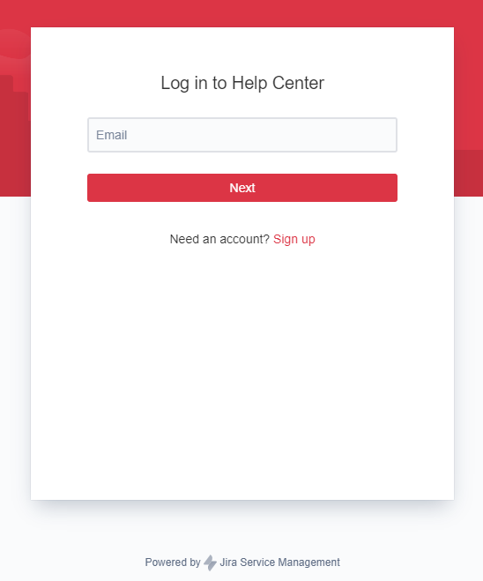
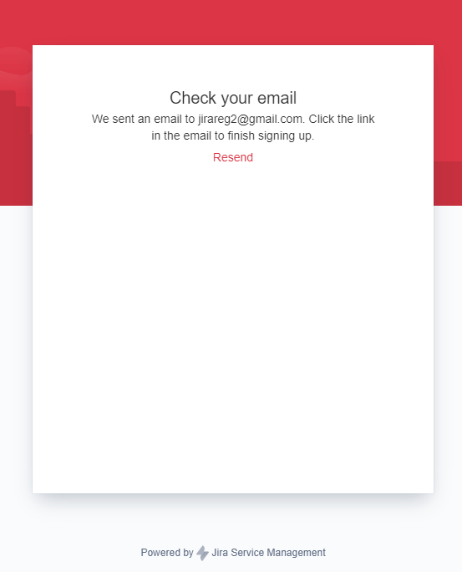
Registration process

Slide 2
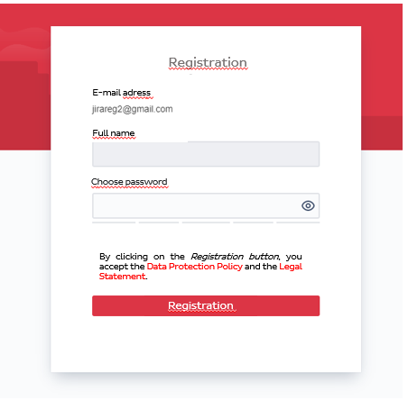
Registration process
After registration, you will receive an email to the specified email address, where you must confirm the registration.
After confirming the e-mail address, you must enter a password of your choice.

Slide 3
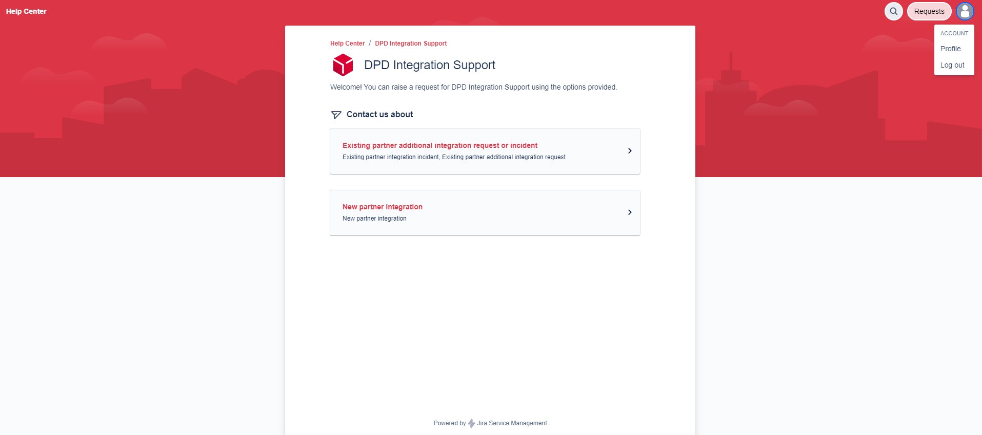
Registration completed
You can edit your data by clicking on the picture icon in the upper right corner and selecting the Profile option.
You can change the language here

Slide 4
Raising a ticket
By clicking on this option, you can raise tickets related error or other integration questions

Slide 5
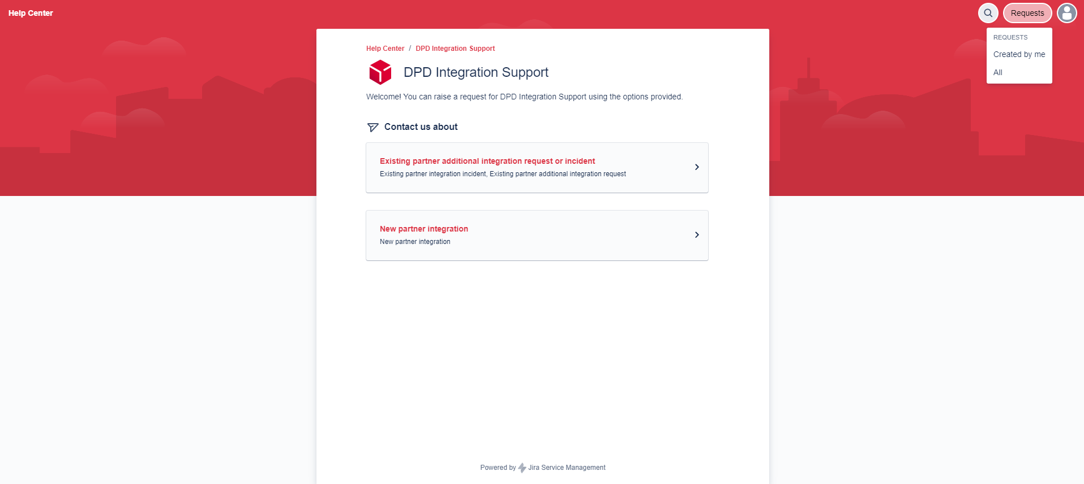
Ticket management
In the upper right corner, under the requests tab, you can find the tickets we have opened.

Slide 6
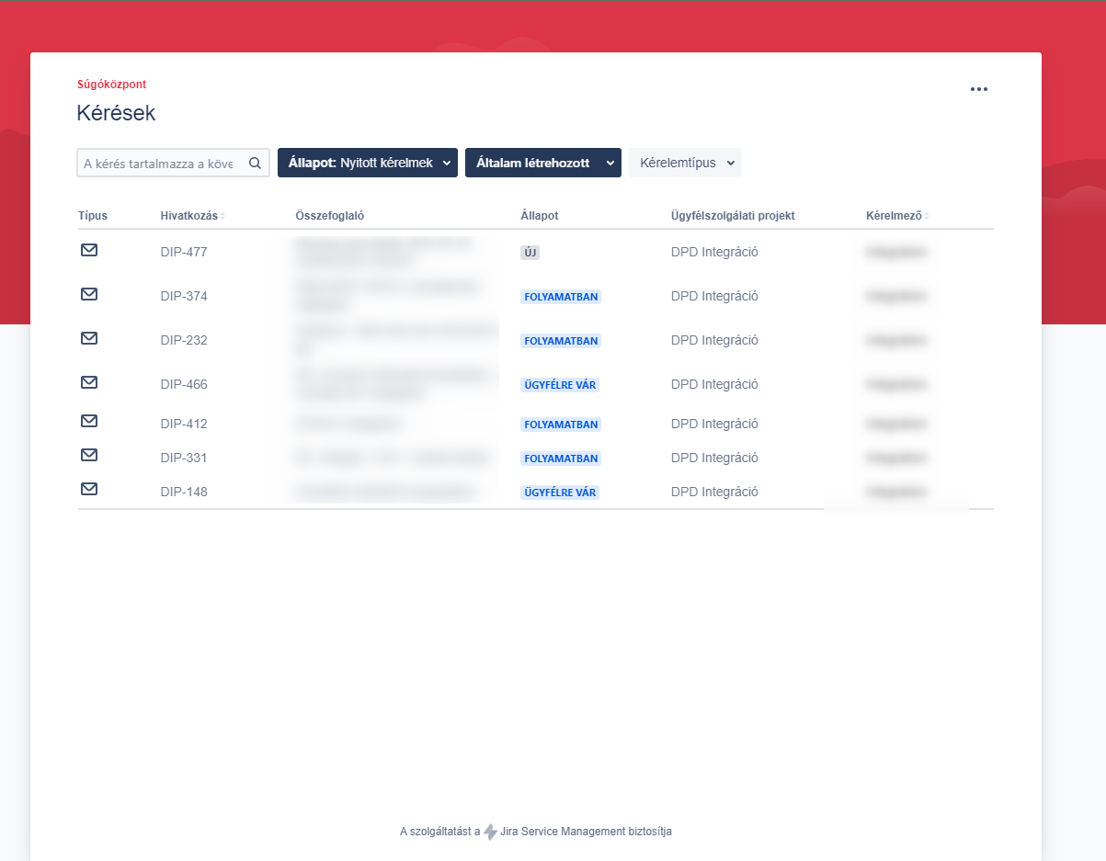
Ticket management
By clicking on the three dots in the upper left corner, you can edit the columns and browse the tickets with different filters.

